Slide 1
INN HOTELS
Supervised Learning - Classification, PGP - Data Science and Business Analytics Arsalaan B. Saiyed
Date – 4th June 2022

Slide 2
Contents / Agenda
Executive Summary
Business Problem Overview and Solution Approach
Data Background and Contents
EDA Results
Data Preprocessing
Model Performance Summary
Regression Model
Classification Model
Appendices
Appendix-A: EDA Results
Appendix-B: Model Performance Summary

Slide 3
Executive Summary
From exploratory analysis and relative importance we can conclude the likelihood of a booking cancellation depends primarily on the following parameters:
Lead time: There is a strong correlation between lead time and cancellation of booking. Higher the lead time the greater the likelihood of cancellation.
Average room price per day: Higher the room price greater the likelihood of booking cancellation.
Segment: From various market segments it was observed that the bookings made online were the most likely to get cancelled. Followed by offline bookings, corporate bookings and no cancellations for complementary bookings.
Speacial Requests: Greater the number of special requests the lesser is the likelihood of the booking being cancelled.
Arrival Month: We observed that the months April to September have the most likelihood of cancellation.
Week/Weekend Nights: It is also observed that if the numeber of weekend or weeknights increases the likelihood of cancellation increases. This means the longer the stay the more likely that it will be cancelled.
Arrival Month: The busiest months are usually June, July and August according and according to our data the most busiest month for 2017 and 2018 was October. October is also the month with the most number of cancellations and on average over the two years June has the highest cancellations followed by July and August.

Slide 4
Executive Summary
Recommendations: Based on the insights from EDA and building classification models to predict the booking cancellation we would like to make the following recommendations:
For bookings with long lead time:
Offer some amount of discount for early payment and incase of last minute cancellation deduct amount for one day booking to compensate for the INNs loss of resources and to arrange another booking.
Send monthly and then weekly confirmation/reminder emails close to the arrival date. If the customer is responsive then we can confirm that they are serious and will be staying with the INN. If the customer is unresponsive we can call to confirm or cancel their booking.
Make sure you the hotels have a solid and reasonable cancellation policy in place.
Average room price: The INN Hotels must stratergize their prices and constantly maintains a competitive rate. A in depth price comparision should be conducted between INN hotels and other similar hotels to determine the best price per room depending on the following factors.
Arrival month: Depending on the arrival month and its respective busyness the hotels must price their rooms appropriately and competitvely.
Repeated guests: Target various coupons/offers for regular guests. Data also shows repeated guests are least likely to cancel bookings.
New guests: Similary target various coupons/offers for first time guests to build popularity and gain trust through great service.
Families: Make your hotels to appear more family friendly by including ads and coupons or offers for family bookings. Data shows that guests with children i.e. families bring in more revenue so, it is good to have an image as a family friendly business.
Drive direct bookings rather than relying on online travel agents. As seen online bookings have the highest cancellation rate. With direct bookings there is a personalized connection and the hotel is better able to push rebooking or vouchers as an alternative to cancellation.

Slide 5
Executive Summary
Recommendations:
Drive direct bookings rather than relying on online travel agents. As seen online bookings have the highest cancellation rate. With direct bookings there is a personalized connection and the hotel is better able to push rebooking or vouchers as an alternative to cancellation.
Upsell value-added packages or amenities during booking. Those who upgrade will have more invested with your hotel and therefore are more committed to their booking.
Pre-arrival emails don’t only have to be for reminders but can also be created to build excitement and anticipation for upcoming stays. Remind guests of their selected room type and ammenities they are sure to enjoy.
Overbook. Overbooking is a tricky maneuver but it can work with contingency plan in place. The idea is to overbook more rooms then you have, in anticipation of cancellations or no shows. To this successfully we must analyze the reservation trends. Based on our data cancellation is most seen in the busiest months so it makes to overbook then. Also, you should have a backup plan, just in case. Shifting a guest to a similar property at the time of check-in could be one way to handle the situation.
Use Length of Stay Restrictions Checkout your competitors’ policies on length of stay restrictions. Some hotels do not allow one night bookings on busy days, or when an event is happening nearby. Longer bookings mean less booking count, which reduces the number of cancellations. Our data also shows the same, the longer the stay the more the cancellations.
Be Responsive and Proactive. Keep a track of cancellations. Your front desk needs to be proactive and responsive. When guests don’t turn up, get in touch as soon as possible. Information is power and gives you the chance to resell the room.

Slide 6
Business Problem Overview and Solution Approach
Problem Overview:
A significant number of hotel bookings are called off due to cancellations or no-shows. The cancellation of bookings impact a hotel on various fronts:
Loss of resources (revenue) when the hotel cannot resell the room.
Additional costs of distribution channels by increasing commissions or paying for publicity to help sell these rooms.
Lowering prices last minute, so the hotel can resell a room, resulting in reducing the profit margin.
Human resources to make arrangements for the guests.
The objective is to analyze the data provided to find which factors have a high influence on booking cancellations, build a predictive model that can predict which booking is going to be canceled in advance, and help in formulating profitable policies for cancellations and refunds.
Solution Approach:
Data Overview & EDA
Data pre-processing
Regression Model Building & Testing
Decision Tree Model Building
Pruning & Model Comparison
Executive Summary - Actionable insights and summary

Slide 7
Data Background and Contents
Observations:
Data was formatted appropriately.
There is no missing or duplicated data
This data is for the years 2017 & 2018
Variable | Description
Booking_ID | unique identifier of each booking
no_of_adults | Number of adults
no_of_children | Number of Children
no_of_weekend_nights | Number of weekend nights (Saturday or Sunday) the guest stayed or booked to stay at the hotel
no_of_week_nights | Number of week nights (Monday to Friday) the guest stayed or booked to stay at the hotel
type_of_meal_plan | Type of meal plan booked by the customer Not Selected – No meal plan selected Meal Plan 1 – Breakfast Meal Plan 2 – Half board (breakfast and one other meal) Meal Plan 3 – Full board (breakfast, lunch, and dinner)
required_car_parking_space | Does the customer require a car parking space? (0 - No, 1- Yes)
room_type_reserved | Type of room reserved by the customer. The values are ciphered (encoded) by INN Hotels.
no_of_special_requests | Total number of special requests made by the customer (e.g. high floor, view from the room, etc)
booking_status | Flag indicating if the booking was canceled or not.
Variable | Description
lead_time | Number of days between the date of booking and the arrival date
arrival_year | Year of arrival date
arrival_month | Month of arrival date
arrival_date | Date of the month
market_segment_type | Market segment designation.
repeated_guest | Is the customer a repeated guest? (0 - No, 1- Yes)
no_of_previous_cancellations | Number of previous bookings that were canceled by the customer prior to the current booking
no_of_previous_bookings_not_canceled | Number of previous bookings not canceled by the customer prior to the current booking
avg_price_per_room | Average price per day of the reservation; prices of the rooms are dynamic. (in euros)
Observations | Variables
36,275 | 19
Table 1: Shape of the data
Table 2: Details

Slide 8
EDA Results – Univariate Analysis
Upon conducting a univariate analysis of the raw data and computing the statistical summary we observed the following:
The average lead time is found to be 85 days and the median is 57 days. We also notice that longer the lead time the more likely the customer would cancel the booking.
Average price per room per day is found to be at a mean of 103 and a median of 99 euros.
Majority (72.1%) of the bookings are for two adults and very few of them (7-8%) having bookings with children.
77.5 % of the customers are given Room Type 1. 76.7% prefer meal type 1 only 3.1 % of customers require parking,
64% bookings were online booking, 29% offline, 5.6% corporate, 1.1% complementary and 0.3% aviation.
Almost half (54.5%) of the bookings have no special requests but the remaining do have 1 special request at least.
67.2% of all the bookings in the data were not cancelled while 32.8% were.
Only 2.6% of the guests are repeated customers
Note: The mean, min, max etc. for all columns are given in the statistical summary in a table in Appendix-A
Link to Appendix slide on data background check

Slide 9
EDA Results – Bivariate Analysis
Upon conducting a bivariate analysis of the raw data we observed the following:
From the heatmap we can see that lead time has a strong positive correlation with booking status. Average price also seems to have a slight positive correlation with booking status.
Across market segments average prices are highest for online bookings and lowest for complementary bookings. We notice a similar pattern for number of cancellations across market segments as it is highest for online bookings and lowest for complementary bookings.
The more special requests a customer has the lesser they are likely to cancel the booking but, we it is also seen that special requests come at a price as the average price per room increases with number of requests.
The higher the room prices are the more likely is the customer to cancel the bookings.
Percentage of cancellation does not significantly differ depending on the number of family members per booking.
Longer the booking is for the more likely is the customer to cancel the booking.
Repeated guests are less likely to cancel bookings.
Based on total guests the busiest months seem to be August, September and October but, based on mean June, July and August seem to be the busiest month.
Link to Appendix slide on data background check

Slide 10
Data Preprocessing
Duplicate value check
Missing value treatment
Outlier check (treatment if needed)
Feature engineering
Data preparation for modeling
Note: You can use more than one slide if needed

Slide 11
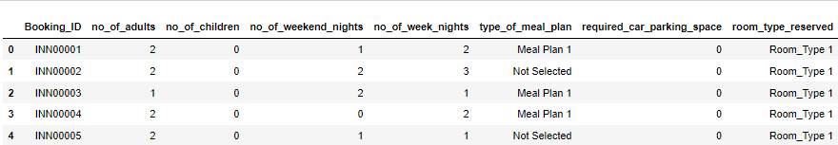
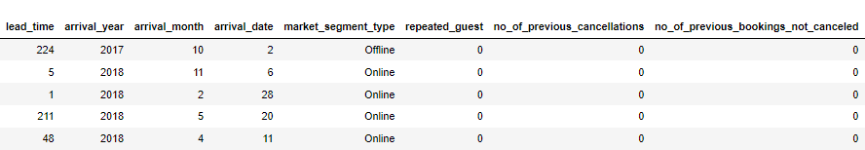
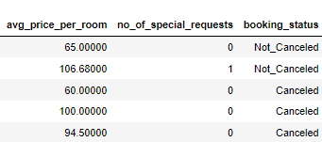
Data Preprocessing
Let’s take a quick look at a small sample of our data. This will help us get some idea of the attributes of the data and also help us understand the degree of cleaning needed before we can build a model.
Random sample of the data (5 rows, 19 columns):

Slide 12
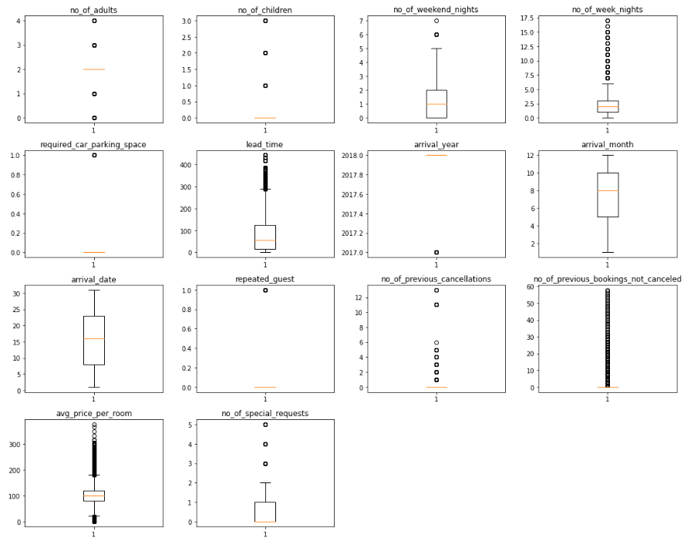
Data Preprocessing
Duplicate Value Check: No duplicate entries were found in the given data
Missing Value Treatment:
Our data has no missing value so no treatment was required.
Outlier Check:
We treated the outliers for average price per room for amounts that were greater than 500 euros because this was not a common price. We replaced all the values over 500 euros with the upper whisker value using the inter quartile range which came out to be 179.55 euros.
All the other outliers are correct data so we don’t treat them.
Feature Engineering:
There was no need for feature engineering.

Slide 13
Model Performance Summary
Overview of ML model and its parameters
Summary of most important factors used by the logistic regression model for classification (prediction)
Summary of key performance metrics for training and test data in tabular format for comparison of logistic regression model
Summary of most important factors used by the decision tree model for classification (prediction)
Summary of key performance metrics for training and test data in tabular format for comparison decision tree model
Link to Appendix slide on model assumptions

Slide 14
Model Performance Summary
Overview of ML model:
Our was to provide INN Hotels insights as to what are the key indicators that show us that if a customer would cancel the booking or not, based on which they will organize their resources and optimize their profits by having maximum occupancy in their hotels and minimize their losses on cancelled bookings and lost resources. For this we used past data to build classification models using logistic regression and a decision tree to predict that if a new customer is likely to cancel their booking or not.
ML model parameters:
Model Selection & Fitting: We build two models for classification and compare the results.
Logistic Regression Model: Statsmodel was used in python to build a model that fit the train data set and tested against the test data set. Then, the model was treated to meet all the linear regression assumptions.
Decision Tree: We will build another model using the DecisionTreeClassifier function. Using default 'gini' criteria to split.
Model Evaluation Criterion: Model can make wrong predictions as:
Predicting a customer will not cancel their booking but in reality, the customer will cancel their booking.
Predicting a customer will cancel their booking but in reality, the customer will not cancel their booking.
Which case is more important? Both the cases are important as:
If we predict that a booking will not be canceled and the booking gets canceled then the hotel will lose resources and will have to bear additional costs of distribution channels.
If we predict that a booking will get canceled and the booking doesn't get canceled the hotel might not be able to provide satisfactory services to the customer by assuming that this booking will be canceled. This might damage the brand equity.
How to reduce the losses? Hotels would want F1 Score to be maximized, greater the F1 score higher are the chances of minimizing False Negatives and False Positives.

Slide 15




Model Performance Summary
Summary of most important factors used by the LINEAR REGRESSION model for prediction:
Pre-processed data was split into training and testing data with a 70:30 ratio.
Using logit from statsmodel library we fit a logistic model to the training data set. F1 was found to be 0.68213 for our first model.
No multicollinearity was detected when VIF was calculated.
Predictor variables having a p-value greater than the selected significance level ( > 0.05 ) were dropped.
We then fit the logit function to the new training set and arrived at a F1 score of 0.68191 for our final model.
Converting coefficients to odds: The coefficients of the logistic regression model are in terms of log(odd), to find the odds we have to take the exponential of the coefficients.
Therefore, odds = exp(b)
The percentage change in odds is given as odds = (exp(b) - 1) * 100
We then calculate the optimal threshold from the ROC-AUC curve and using that build a new logistic model
We also tried using the precision-recall curve to see if we can find a better thresholds.
We then compare all the models and select the best performing one (Follow hyperlinks for comments on different models)

Slide 16
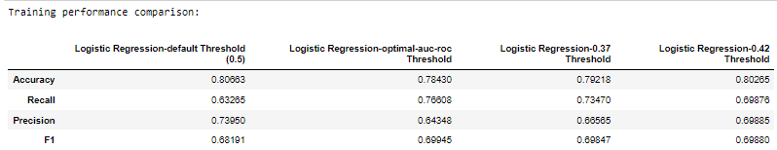
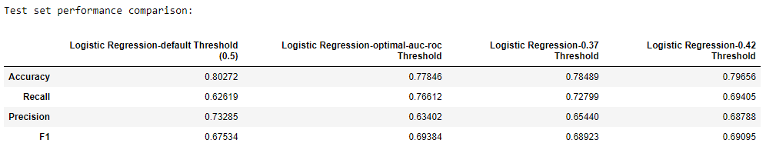
Model Performance Summary
Summary of key performance metrics for training and test data in tabular format for comparison of logistic regression model:
Conclusion:
We can conclude that the threshold 0.42 has the highest accuracy and F1 score for the training and testing data set are slightly lower than the optimal threshold model but we need least errors so we pick the model with the best F1 score. Hence, it would be our best logistic regression model.

Slide 17
Model Performance Summary
Summary of most important factors used by the DECISION TREE model for prediction:
Pre-processed data was split into training and testing data with a 70:30 ratio.
Using DecisionTreeClassifier library we fit a decision tree model to the training data set. F1 was found to be 0.99117 for our first model. Our model was overfitting so we resolved this.
Using GridSearchCV we apply pre-pruning before building the decision tree. Using the grid search parameters we get model with a F1 score of 0.77326.
Then using the cost complexity method we calculate various alphas and their impurities. Using different alphas we plot F1 score against the alpha values for training and testing set and determine the most optimal alpha for the highest F1 scores for training and testing data set.
Although the decision tree might look complex and hard to visualize, we leave it as is because this is the most optimal machine learning model.
We then compare all the models and select the best performing one. (Follow hyperlinks for comments on different models)

Slide 18
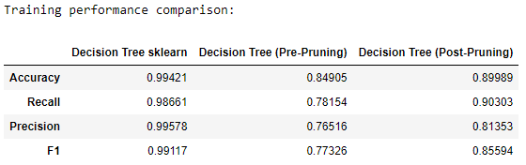
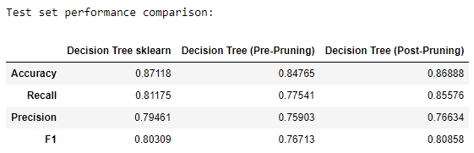
Model Performance Summary
Summary of key performance metrics for training and test data in tabular format for comparison of decision tree model:
Conclusion:
Post-pruning model has a higher F1 and accuracy score for both training and testing data as compared to the pre-pruning model.
The post pruning model seems to be more reliable as the performance for the training and testing data are relatively similar.
The objective was minimize false positives and false negatives therefore, we will pick the model with the highest F1 score which is the post pruning model.

Slide 19
APPENDIX A – EDA Results (Univariate Analysis)

Slide 20
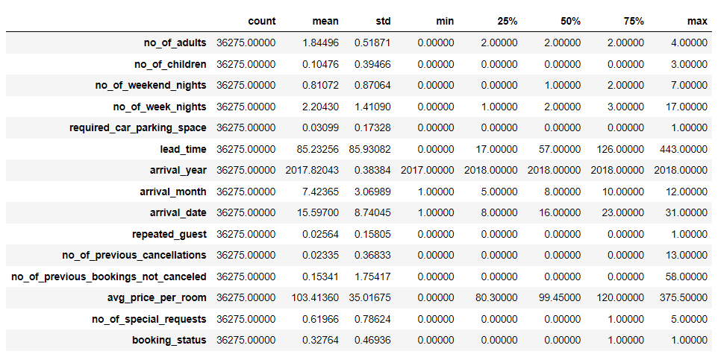
APPENDIX A: Statistical Summary

Slide 21
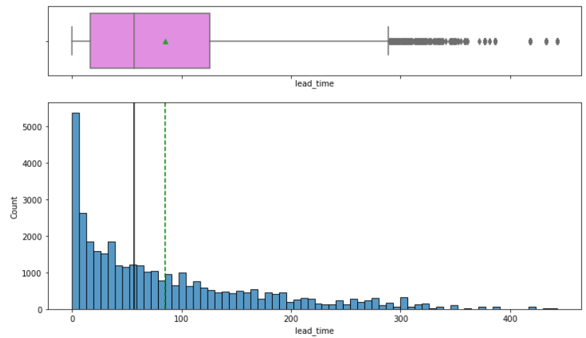
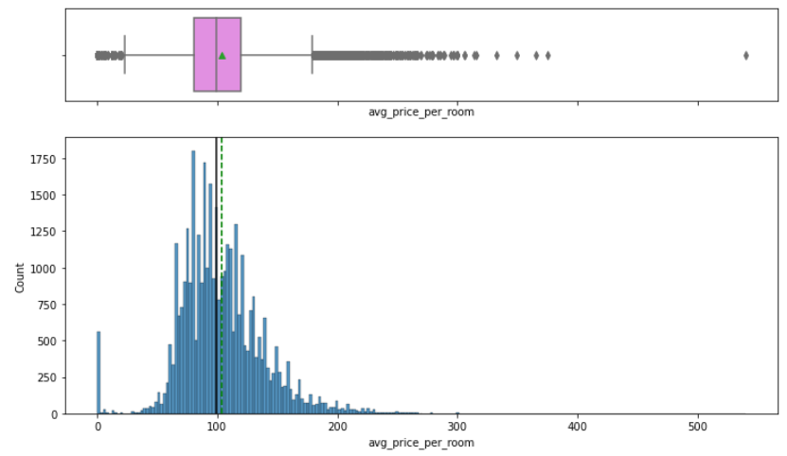
APPENDIX A: Univariate Analysis
Mean: 85.23256 days
Median: 57 days
Strong Right-skew
Mean: 103.42354 Euros
Median: 99.45000 Euris
Light Right-skew

Slide 22
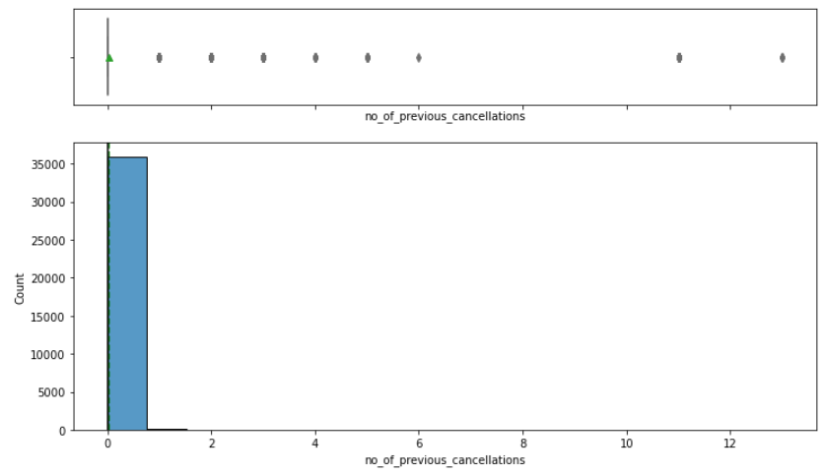
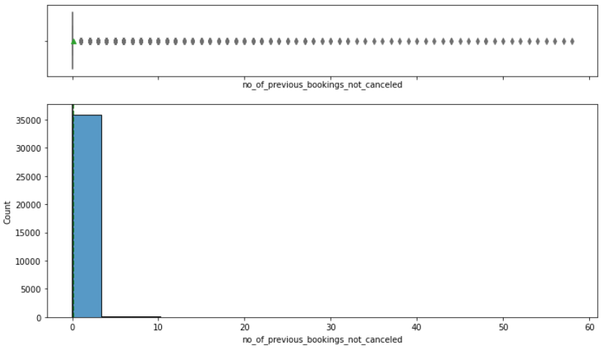
APPENDIX A: Univariate Analysis
The two graphs show us that most customers have zero cancellations and a very small percentage has at least once cancellation. Most customers are not repeated customers because they don’t have any value for both the parameters.

Slide 23
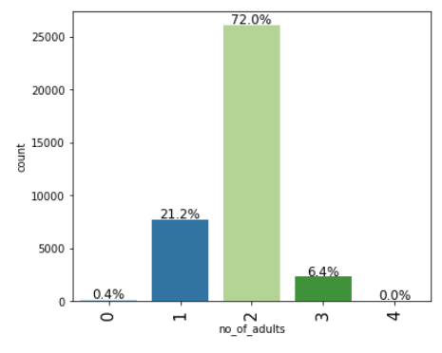
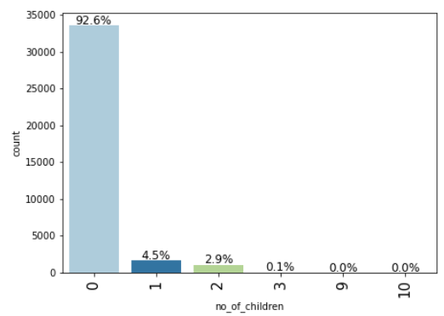
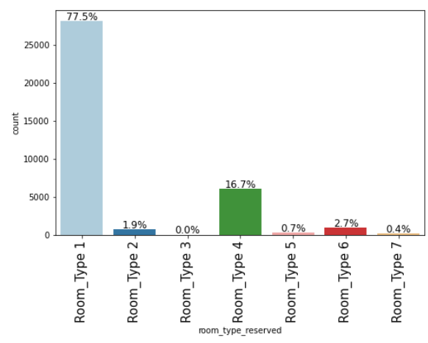
APPENDIX A: Univariate Analysis

Slide 24
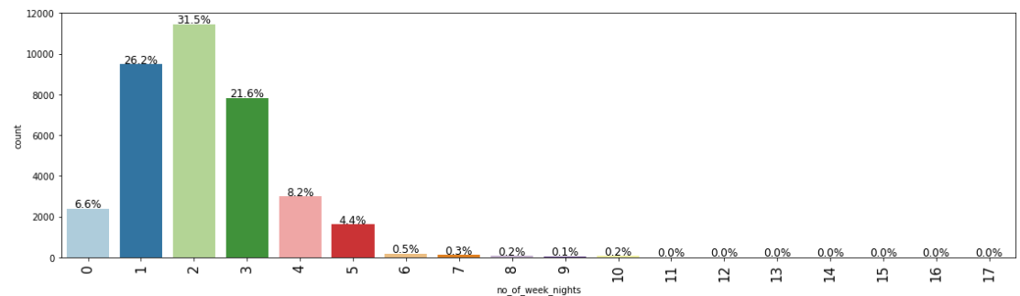
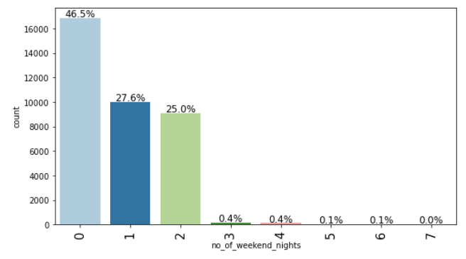
APPENDIX A: Univariate Analysis
Most bookings are for short stays and most of them are over the weekend

Slide 25
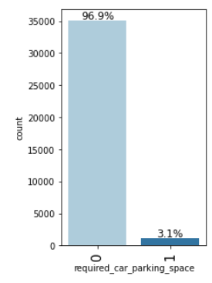
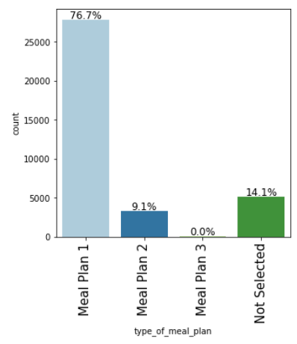
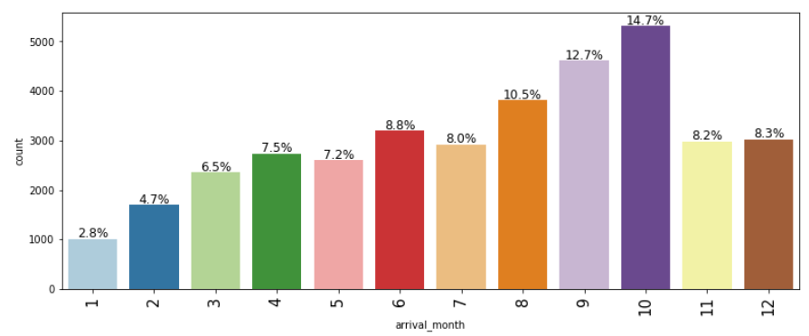
APPENDIX A: Univariate Analysis

Slide 26
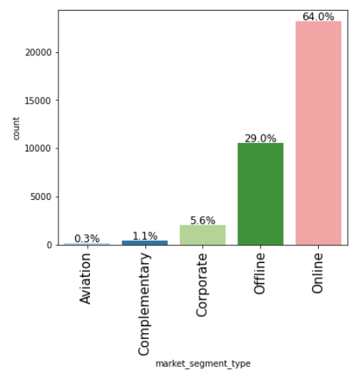
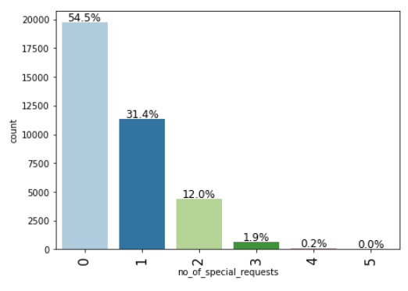
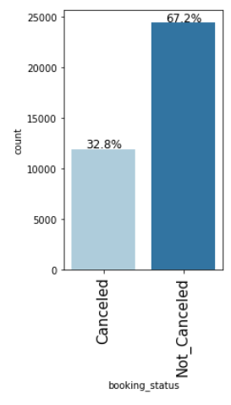
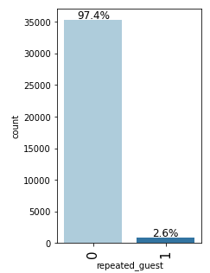
APPENDIX A: Univariate Analysis

Slide 27
APPENDIX A – EDA Results (Bivariate Analysis)

Slide 28
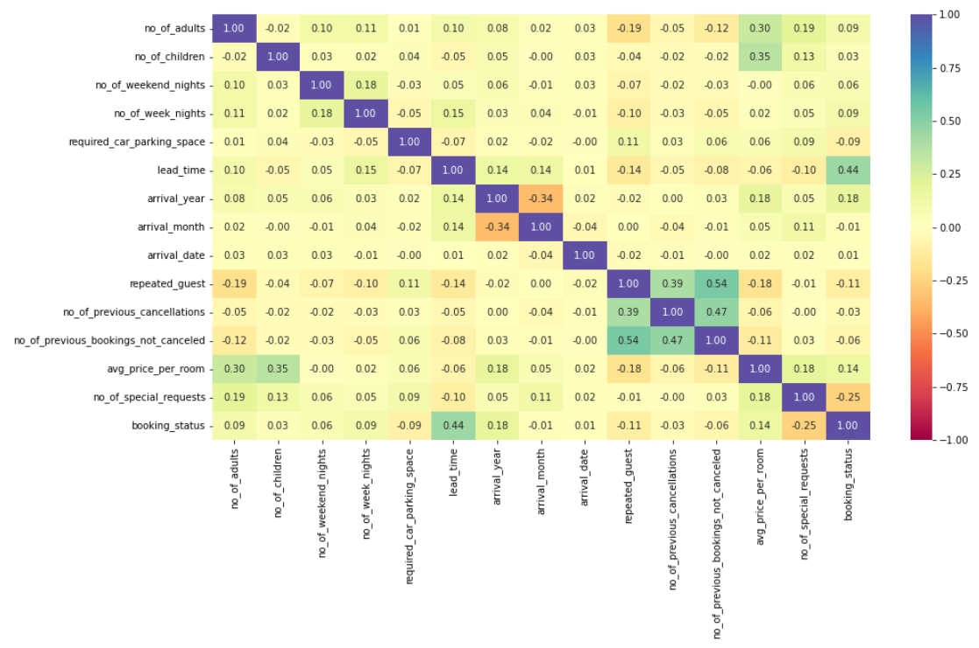
APPENDIX A: Bivariate Analysis

Slide 29
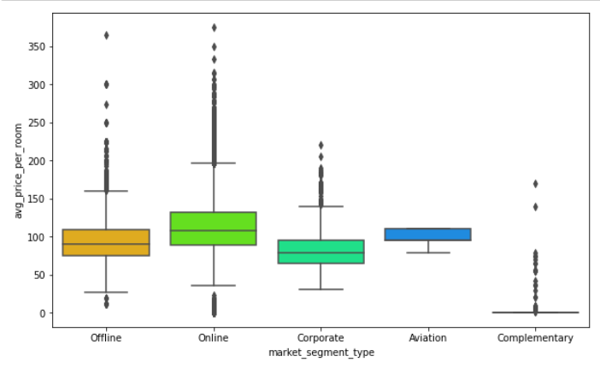
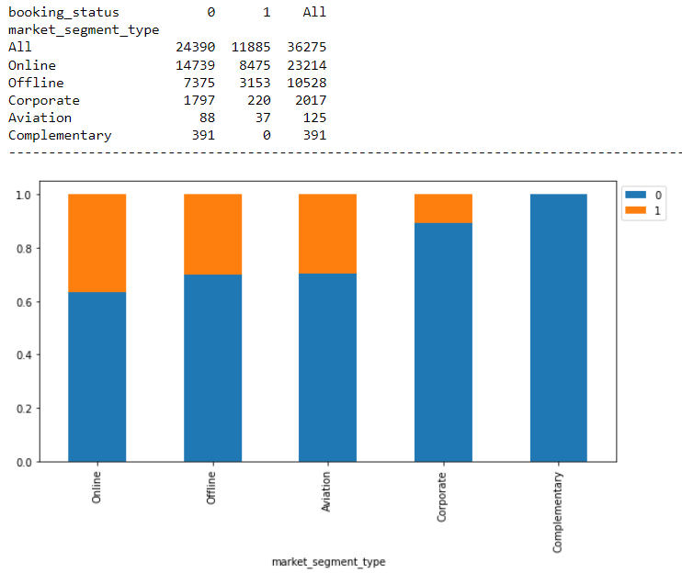
APPENDIX A: Bivariate Analysis
Most bookings are made online and prices for online booking are highest.
Lowest cancellation and prices are for complementary booking.
Aviation bookings also have a high proportion or cancellations.

Slide 30
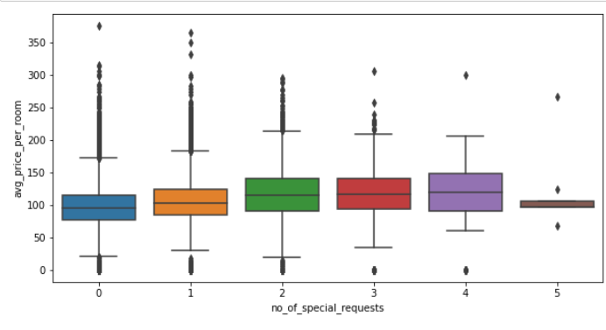
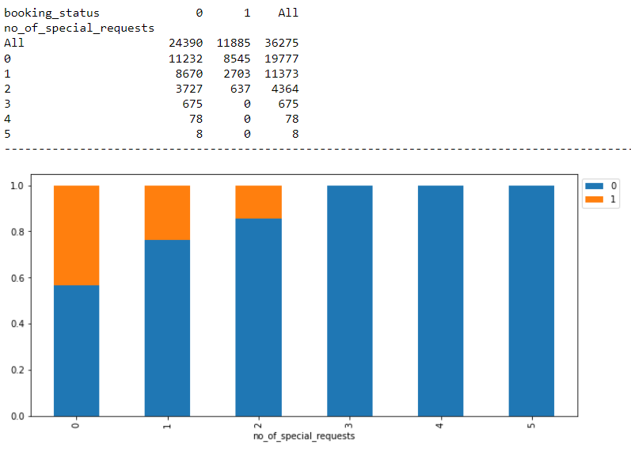
APPENDIX A: Bivariate Analysis
Price increases with number of special requests.
Higher the special requests the more the customer is invested in the booking the lesser the likelihood of cancellation.

Slide 31
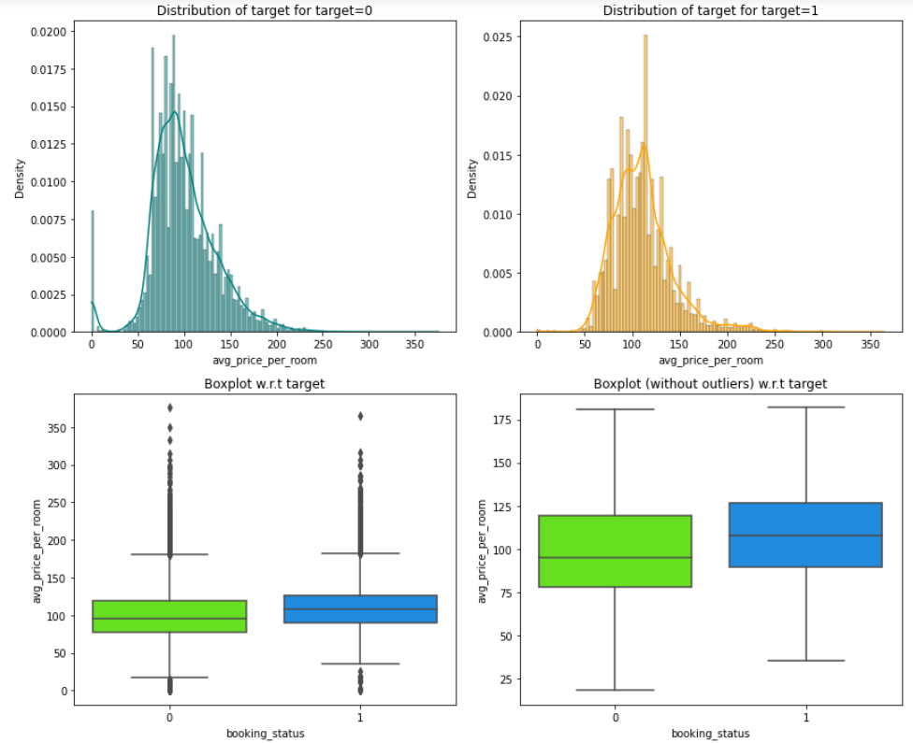
APPENDIX A: Bivariate Analysis
The average room price follows a normal distribution curve.
The rooms with higher prices are more likely to be cancelled.

Slide 32
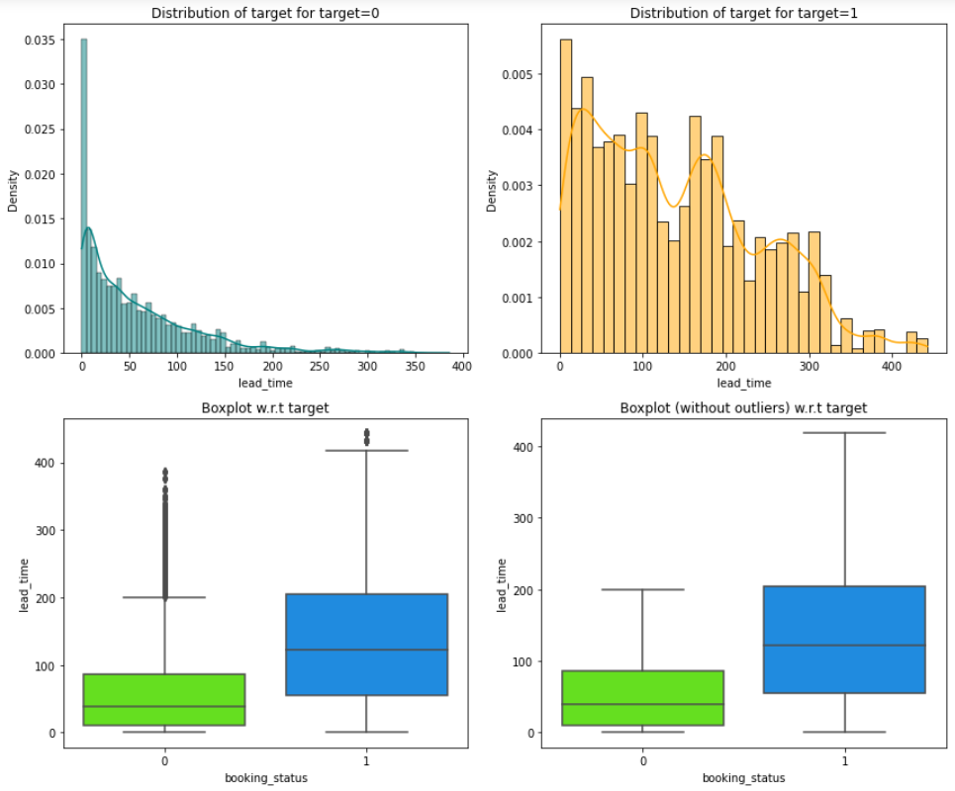
APPENDIX A: Bivariate Analysis
The bookings with higher lead times are more likely to be cancelled.

Slide 33
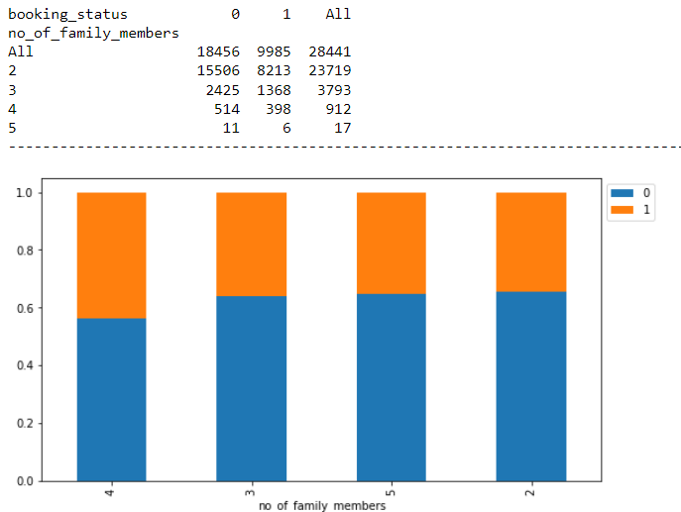
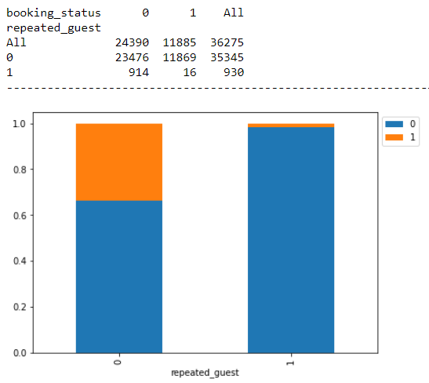
APPENDIX A: Bivariate Analysis

Slide 34
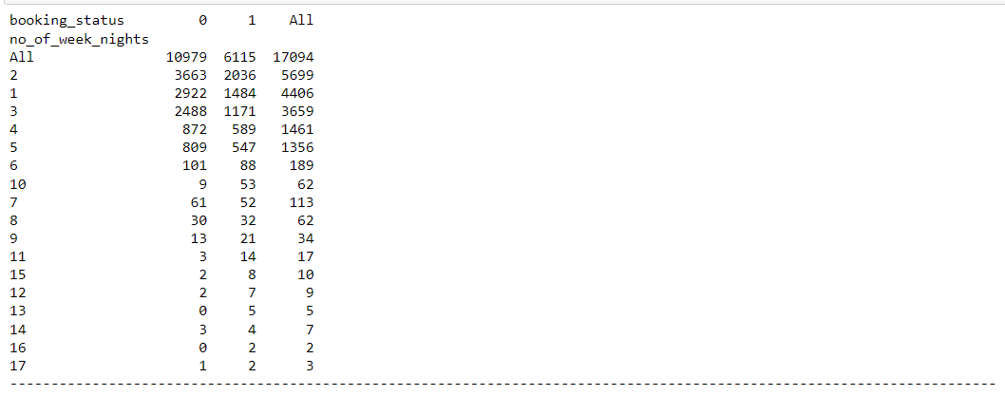
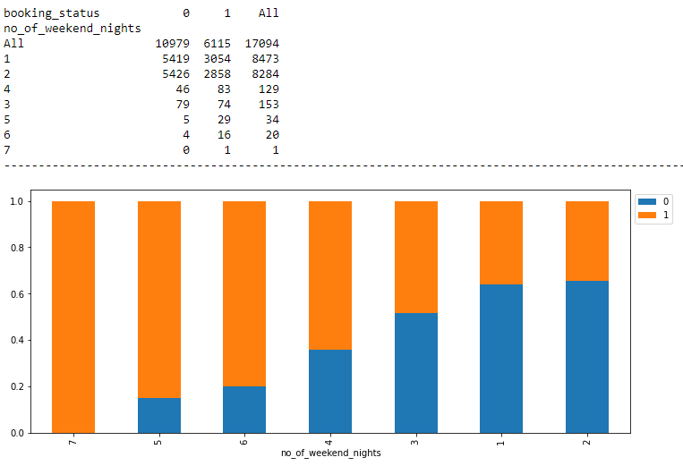
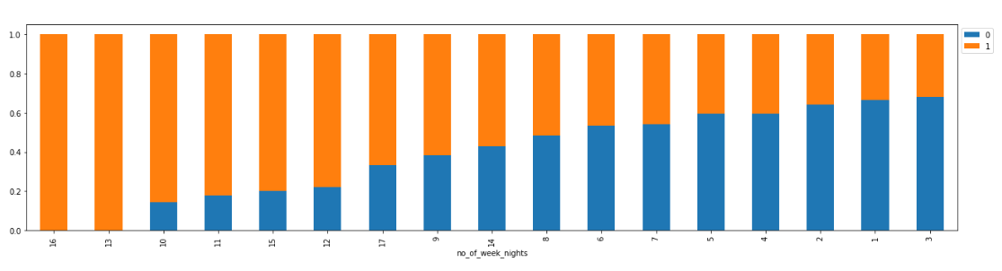
APPENDIX A: Bivariate Analysis

Slide 35
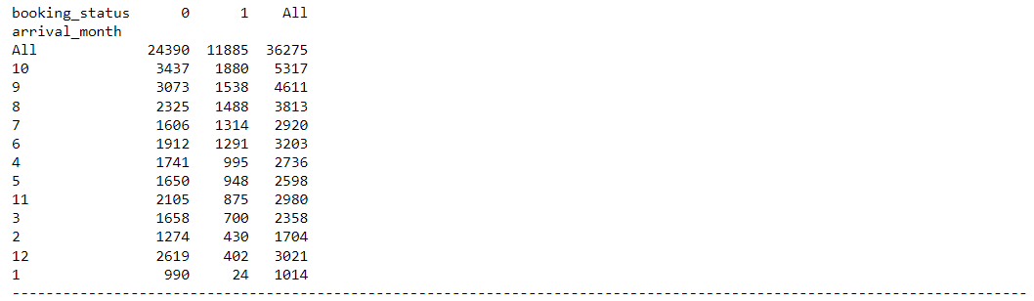
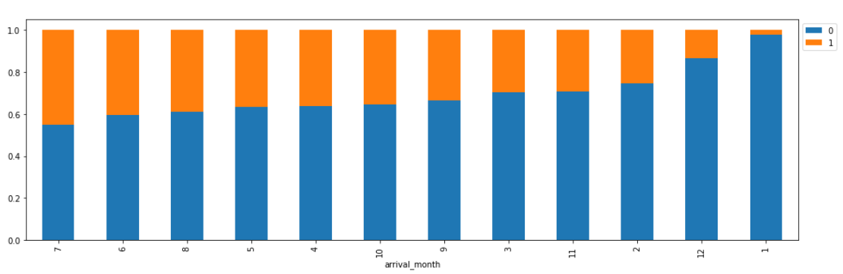
APPENDIX A: Bivariate Analysis

Slide 36
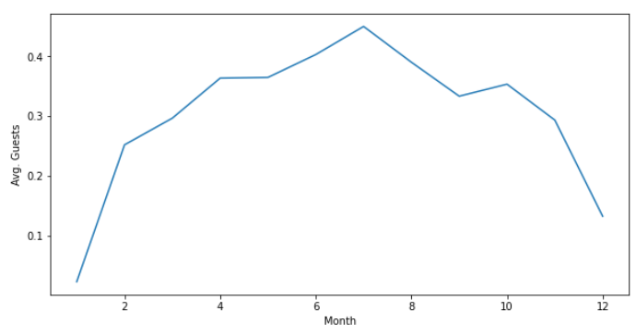
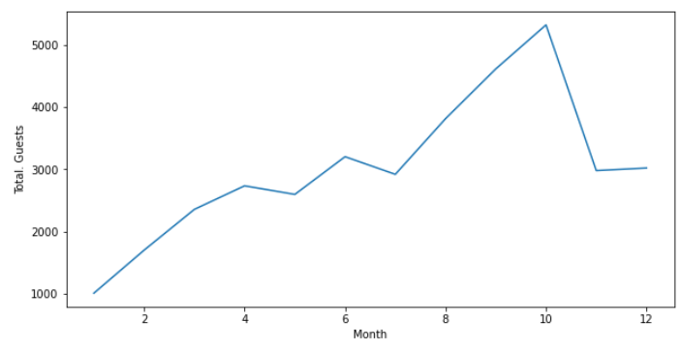
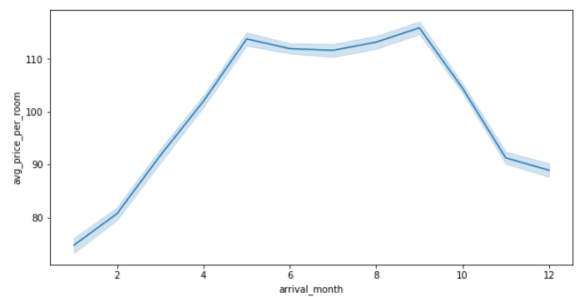
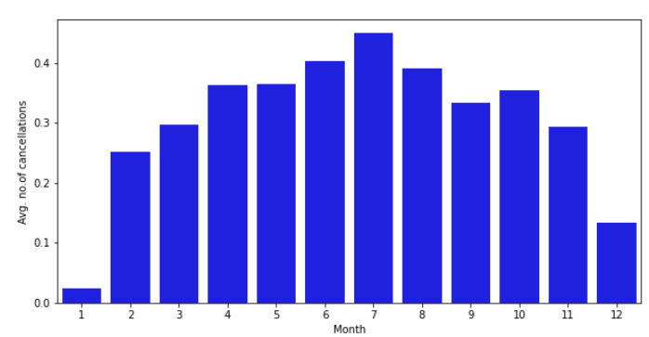
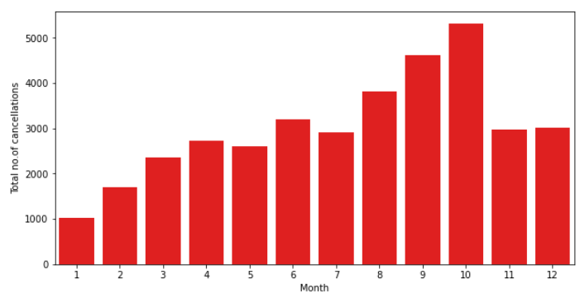
APPENDIX A: Bivariate Analysis
Average guests and average price is highest in the same in the busiest middle months of the year.
Average guests and number of cancellations is the same in the busiest middle months of the year.
Total guests and total cancellations also follow the same trends as each other.

Slide 37
APPENDIX B – Model Performance Summary

Slide 38
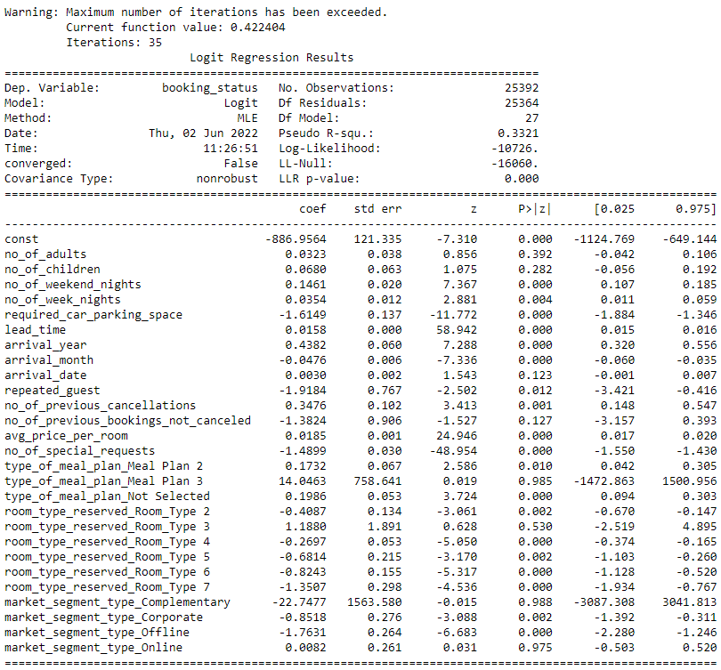

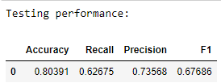
First Logistic Regression Model

Slide 39
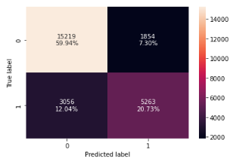
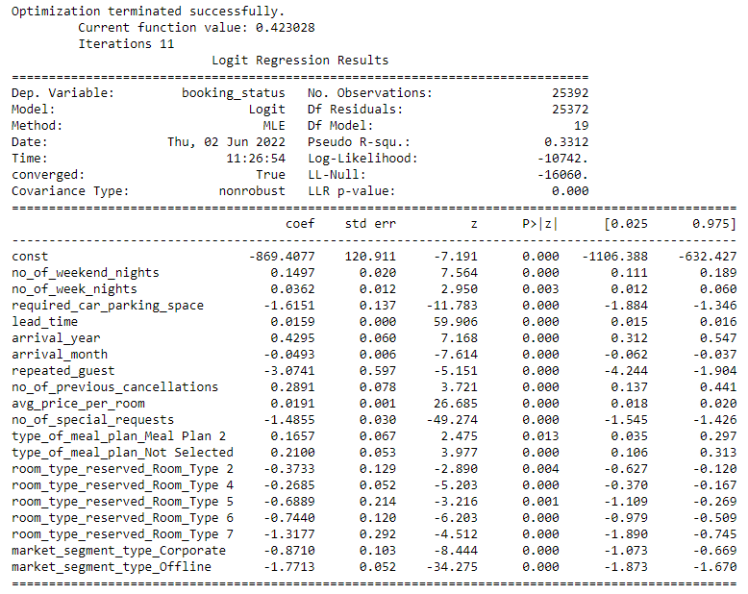
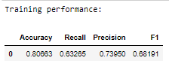
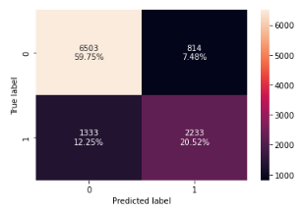

Final Logistic Regression Model (Default Threshold = 0.5)

Slide 40





Model using ROC-AUC Curve
Optimal threshold value from the ROC-AUC curve was found to be:
0.33300753336836625
Observation:
ROC-AUC model performance slightly better than the default threshold model.

Slide 41









Model using Precision-Recall Curve
Threshold = 0.42
Threshold = 0.37

Slide 42





First Decision Tree Model
Observations:
The training model is overfitted as our performance on testing data is relatively weaker.
Lead time, average price per room per day and market segment are the top three important feature in this model tree

Slide 43


Pre-pruning using Grid Search - Decision Tree Model

Slide 44





Pre-pruning using Grid Search - Decision Tree Model
Observations:
The training and test performance parameters are relatively similar.
The decision tree has:
Max depth: 7
Max leaf nodes: 60
Min samples split: 100

Slide 45






Cost Complexity Method- Decision Tree Model
Observations:
The best alpha value was found to be:
0.0001226763315516706

Slide 46

Cost Complexity Method- Decision Tree Model

